Slide 1
MQTT

Slide 2
Outline
Introduction
Expected Result
MQTT with Terminal
MQTT with Node-RED

Slide 3
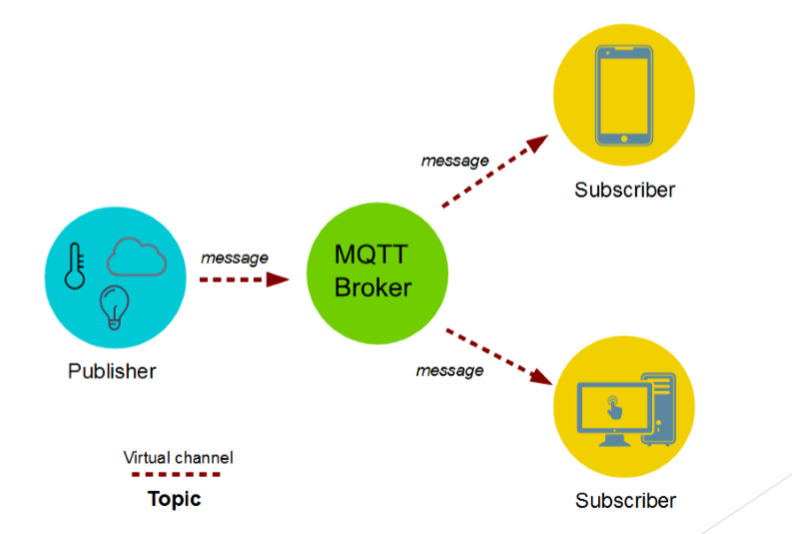
Introduction
About MQTT
From: https://www.survivingwithandroid.com/2016/10/mqtt-protocol-tutorial.html

Slide 4
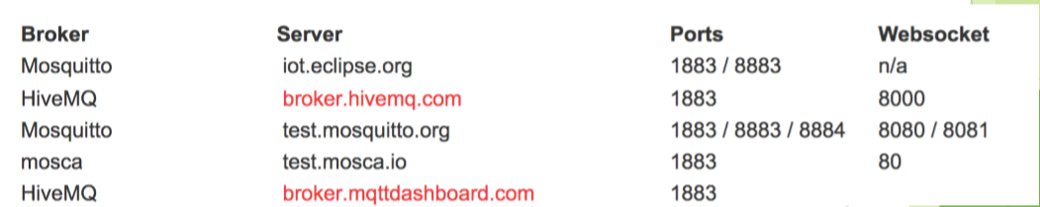
Introduction
MQTT broker uses the topic to filter the clients that will receive the message.
Install MQTT broker in your local system
There are also some available brokers on Internet
From: https://diyprojects.io/8-online-mqtt-brokers-iot-connected-objects-cloud/#.WjsThVT1Uxd

Slide 5
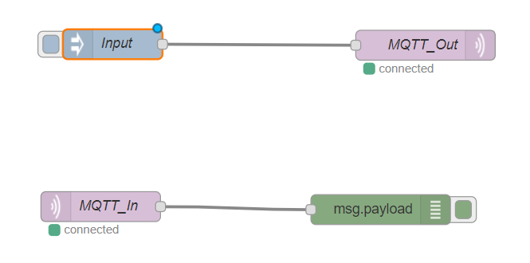

Expected Result
Click this node to send message.

Slide 6
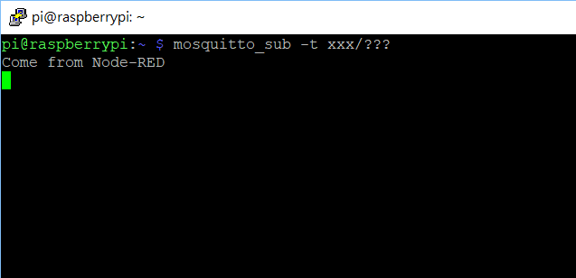
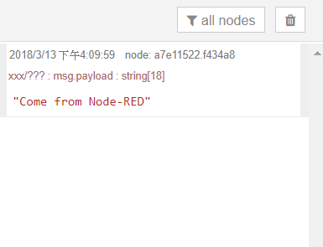
Expected Result
We want to get the same message among different interface.

Slide 7
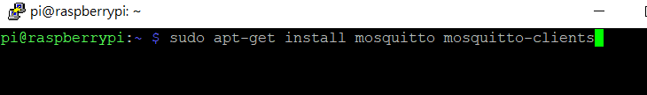
MQTT with Terminal
Install mosquitto(MQTT brocker from eclipse)
Open terminal or SSH and input ” sudo apt-get install mosquitto mosquitto-clients ” to install mosquito.
Wait a moment until system finishes to install.
From:https://diyprojects.io/8-online-mqtt-brokers-iot-connected-objects-cloud/#.WjsThVT1Uxd

Slide 8
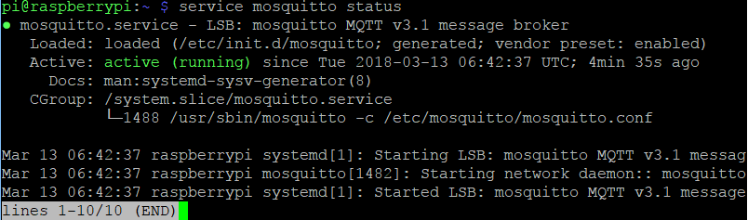
MQTT with Terminal
Check it is running as brocker or not
Input ” service mosquitto status ” to check.
If you see “active(running)” means you successful to run.
Press “Ctrl-c” to leave

Slide 9
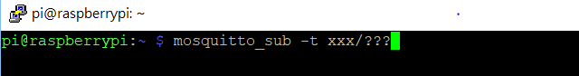
MQTT with Terminal
Start to subscribe
Input ” mosquitto_sub -t xxx/???” to receive messages.
xxx /??? is topic name , you can change to other words.

Slide 10
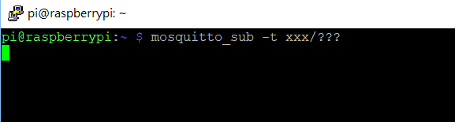
MQTT with Terminal
Start to subscribe
The system will stop and wait message to be sent.

Slide 11
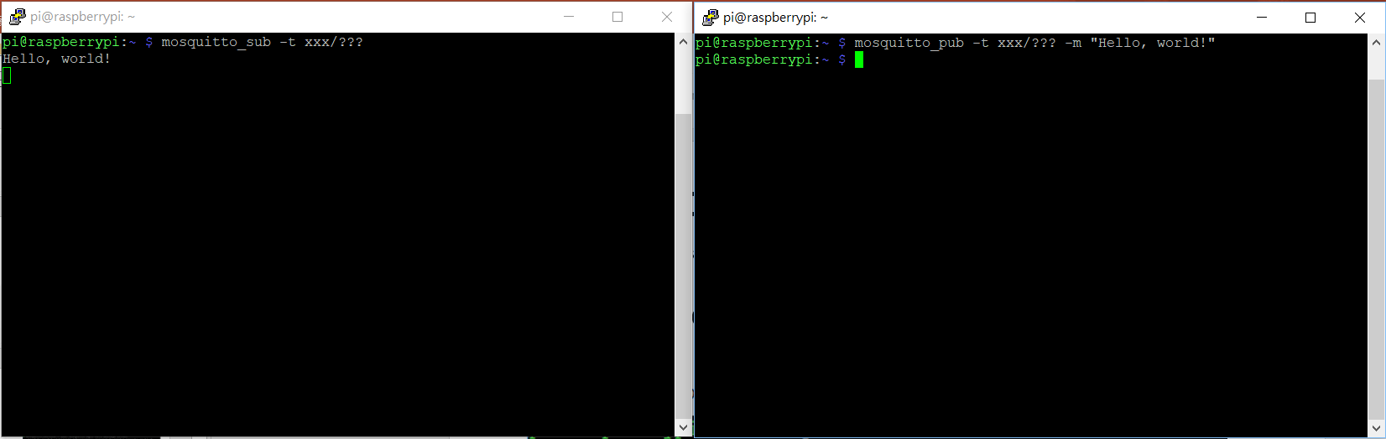
MQTT with Terminal
Test it works or not
Open another terminal and input “mosquitto_pub -t xxx/??? -m "Hello, world! "“ to test it works or not.
If you successful , you can see subscribe get “Hello, world!” message.

Slide 12
MQTT with Terminal
Leave
If you finish , press “Ctrl-c” to leave subscribe , but suggest don’t leave now , we use these two terminal later.

Slide 13
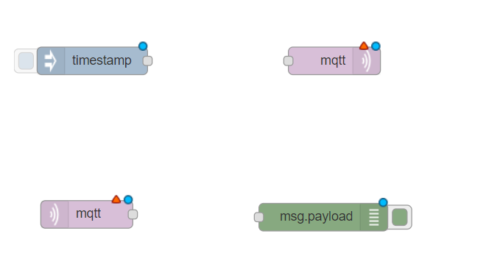
MQTT with Node-RED
Open other terminal to start Node-RED.
Drag mqtt node from input, other mqtt node from output and inject node onto the workspace from the palette

Slide 14
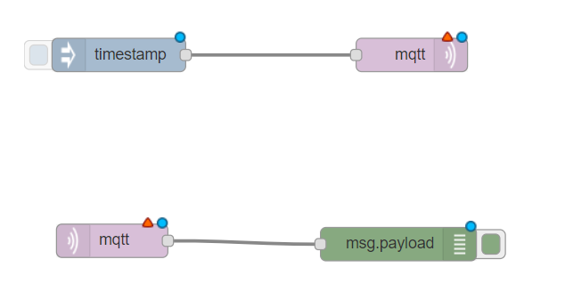
MQTT with Node-RED
Wire these nodes together like:

Slide 15
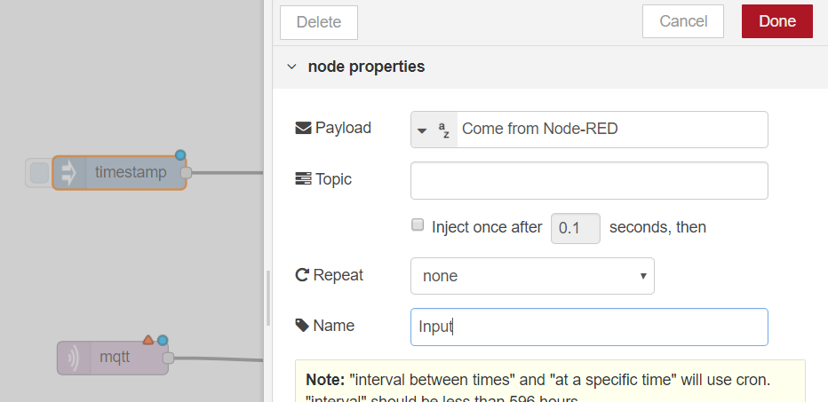
MQTT with Node-RED
Double click the inject node and modify properties as follows:
5
String
2
3
1
4

Slide 16
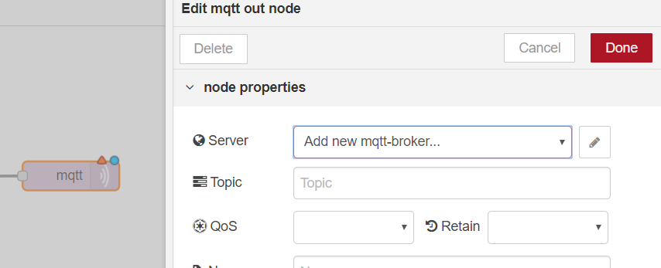
MQTT with Node-RED
Double click the mqtt node(output) and follow below steps.
2
1

Slide 17
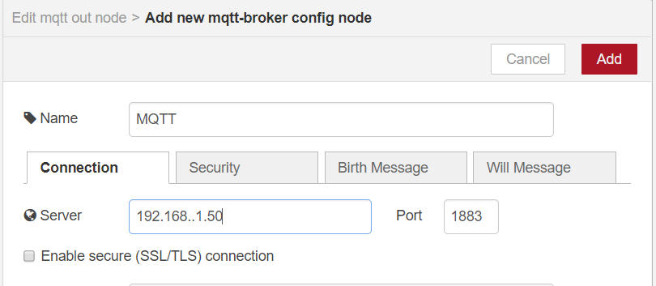
MQTT with Node-RED
Below window will appear and modify properties as follows:
3
1
2
Input your Pi’s ip

Slide 18
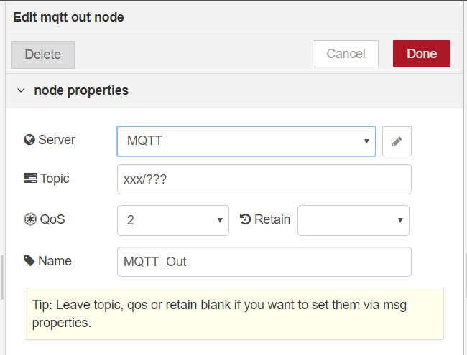
MQTT with Node-RED
Come back this window and modify properties as follows:
3
1
Topic name you set before
2

Slide 19
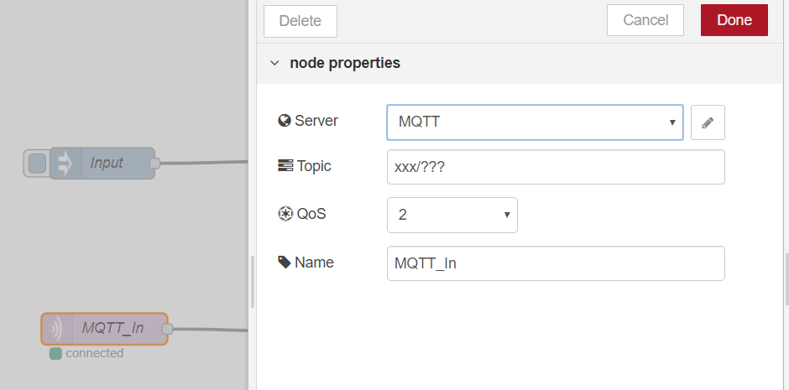
MQTT with Node-RED
Double click the mqtt node(input) and follow below steps.
4
2
Topic name you set before
3
1

Slide 20
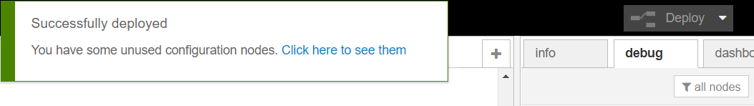
MQTT with Node-RED
Click the deploy button.
2
1

Slide 21
Result
Click this node to send message

Slide 22
Result
These two subscribe will receive message.

Slide 23
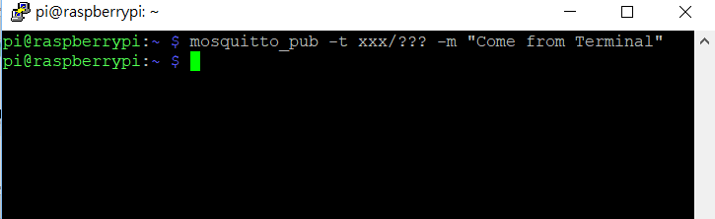
Result
Send message from Terminal.

Slide 24
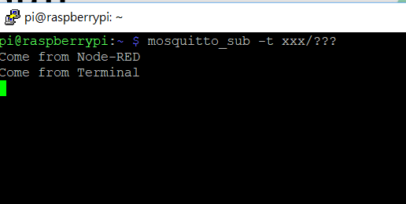
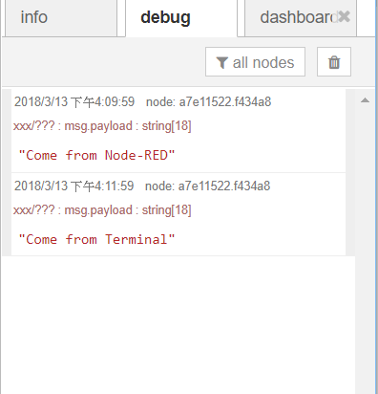
Result
These two subscribe will receive message.

Slide 25
Thank you😃

